Slide 1
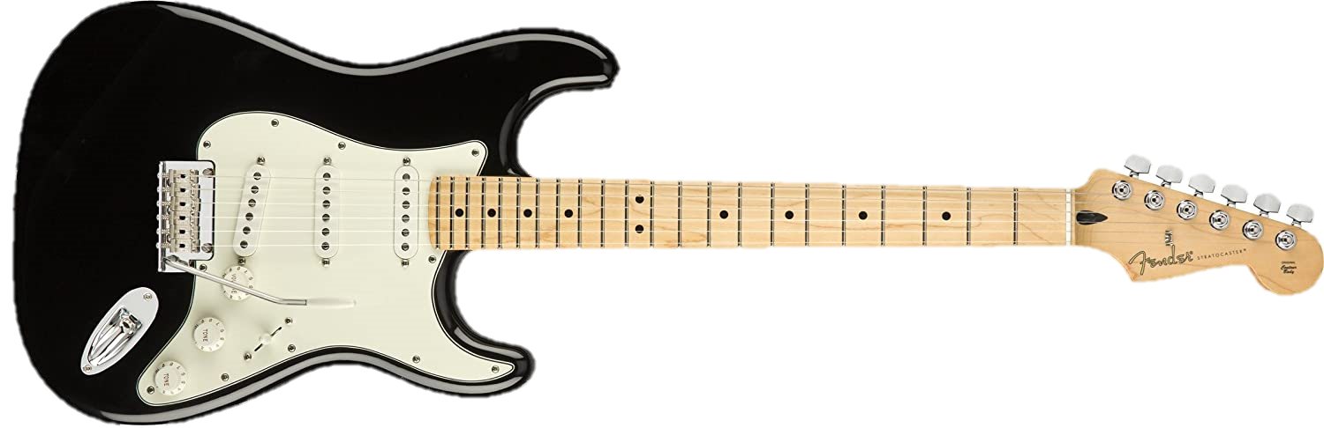
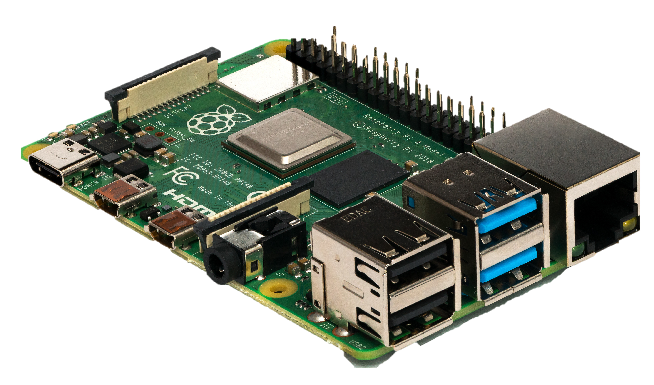
Guitar Effects pedal through raspberry pi
ECE3551 Micro computer Systems 1
Rauly Baggett and Talon Holton

Slide 2
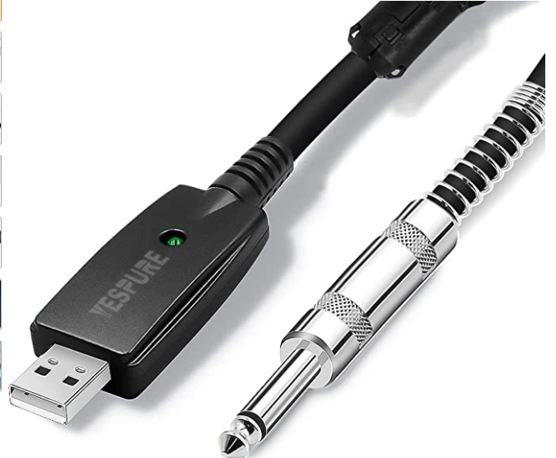
Goal:
Implement 4 guitar effects through buffer manipulation and filtering.
Components used:
Quarter inch -> usb adapter
Raspberry Pi model 3b
Breadboard and push buttons
Fender Stratocaster Electric guitar

Slide 3
Desired Effects:
Delay -> Reverb
Fade
Clip Distort
Read from usb into buffer
Apply effect
Write to output stream
Implementation:
Begin by reading data from usb adapter into the buffer of size 1024 (variable)
Apply desired effect
Write to output stream

